Slide 1
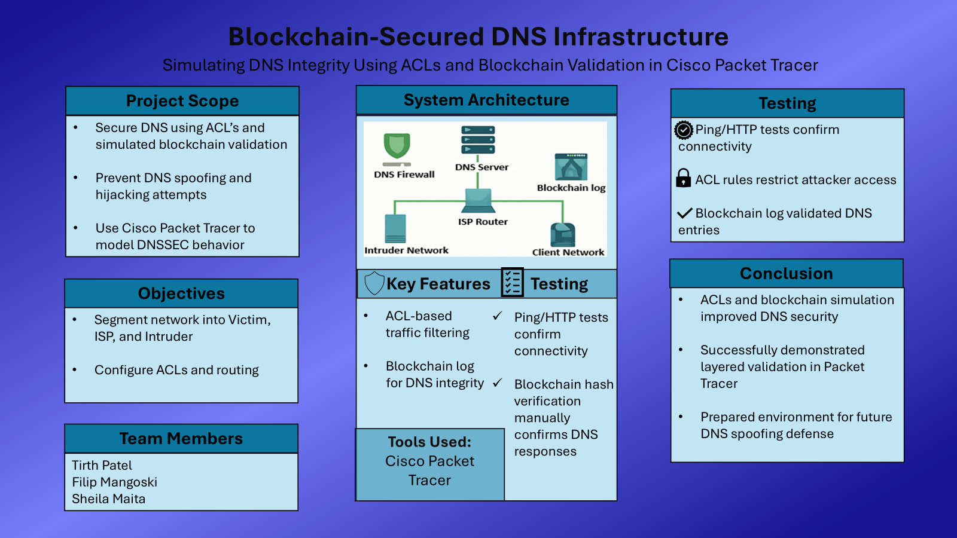

Slide 2
Blockchain-Secured DNS
Infrastructure
By: Filip Mangoski, Tirth Patel, and Sheila Maita

Slide 3
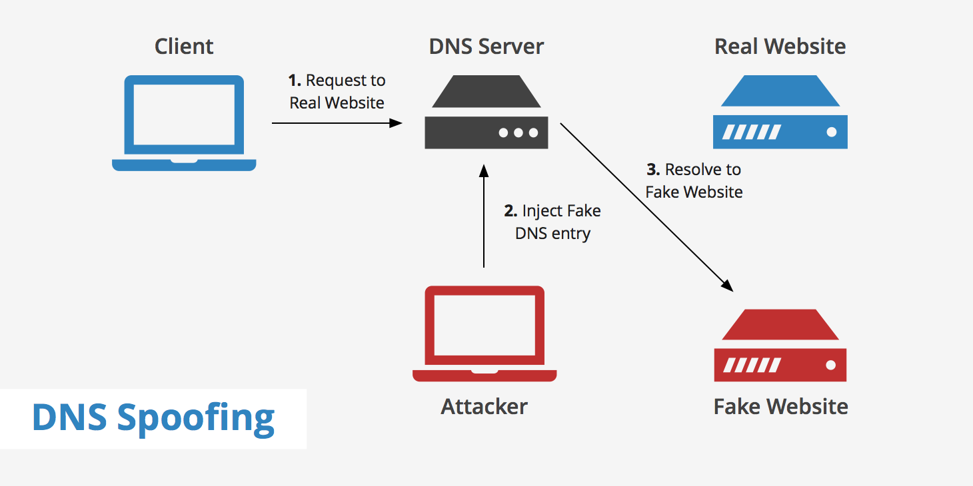
The DNS Spoofing Problem
DNS is a protocol that translates domain names to IP addresses
Problem
Bad actors can exploit DNS to redirect users (i.e. spoofing)
DNS lacks integrity checks
High risk of phishing attacks, data theft, & network compromise
Source: https://www.keycdn.com/support/dns-spoofing

Slide 4

Blockchain-Secured DNS Infrastructure
Design secure DNS infrastructure (Cisco Packet Tracer)
Victim Network:
DNS Server
Blockchain Validation Server
Web Server
Two (2) Client PCs
Intruder Network will simulate DNS spoofing attempts
Blockchain functionality
Show verification status of request
Redirect to show DNS response was invalid
Goal: simulation of how layered validation
(DNSSEC + blockchain) can prevent spoofing
Stakeholders:
DNS Administrators
System Architects
Cybersecurity Analysts
Compliance teams

Slide 5
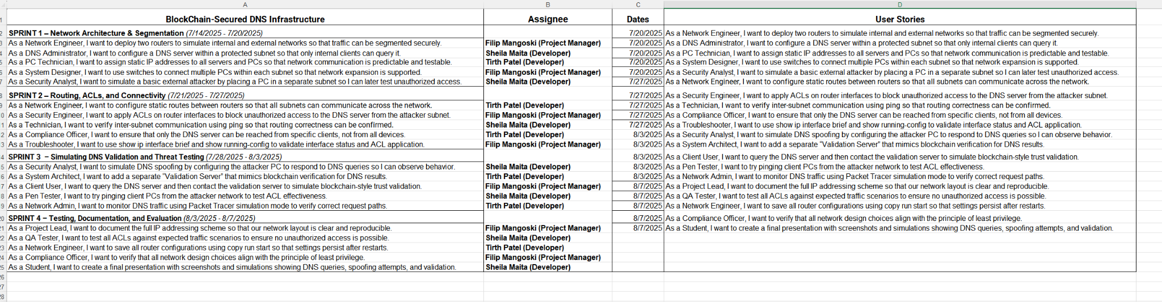
SCRUM

Slide 6
Project Timeline
Week 1: 7/14 - 7/20
Week 2: 7/21 - 7/27
Week 3: 7/28 - 8/3
Week 4: 8/4 - 8/7
Sprint 1: Network Architecture and Segmentation
Sprint 2: Routing, ACLs, and Connectivity
Sprint 3: Simulating DNS Validation and Threat Testing
Sprint 4: Testing, Documentation, and Evaluation
Blockchain-Secured DNS Infrastructure

Slide 7




Tools Used
Packet Tracer
Used to build network
Simulate Blockchain validation
Simulate DNS spoofing
Discord
Group meetings and additional communication
Github
Used to save progress and collectively work on the network
Google Drive
Used for slides, excel sheets, and other files

Slide 8
DEMO

